Slide 1
Medicine Tracking System
Blockchain

Slide 2
ABSTRACT
The pharmaceutical industry faces significant challenges in ensuring the safety, authenticity, and efficiency of its supply chain. To address these challenges, this project proposes the development of a medicine tracking system leveraging blockchain technology. The system aims to enhance transparency, traceability, and accountability throughout the pharmaceutical supply chain, from raw material sourcing to retail distribution. By utilizing blockchain's immutable ledger and smart contracts, the system enables secure and transparent tracking of medicines, ensuring that each product's journey can be traced and verified with integrity. This document outlines the design, implementation, and future directions of the proposed medicine tracking system, highlighting its potential to revolutionize pharmaceutical supply chain management. The user-friendly platform, developed with a combination of Solidity for smart contract development, Ethereum for the underlying blockchain infrastructure, Truffle for the development environment, and React for the user interface, empowers users with greater control and efficiency in supply chain management. This project goes beyond simply streamlining the medicine tracking process. The application developed is essentially a Medicine Tracking System which is a part of the pharmaceutical supply chain process

Slide 3
INTRODUCTION
The medical tracking system is a complex network involving multiple stakeholders, including manufacturers, distributors, retailers, and consumers. With the increasing global demand for pharmaceutical products, ensuring the safety, authenticity, and integrity of medicines has become paramount. However, the existing supply chain management systems often lack transparency and traceability, leading to challenges such as counterfeit drugs, drug diversion, and inefficient inventory management. To address these challenges and enhance the efficiency of pharmaceutical supply chain management, the implementation of a robust medicine tracking system is essential. This chapter provides an overview of our project, which aims to develop a comprehensive medicine tracking system leveraging blockchain technology.

Slide 4
PROBLEM DEFINITION
The pharmaceutical supply chain faces numerous challenges, including counterfeit drugs, inefficient tracking systems, and lack of transparency. Current methods for tracking medicines often rely on centralized databases, which are vulnerable to data manipulation and hacking. Moreover, the lack of transparency in the supply chain can lead to issues such as product recalls, regulatory non-compliance, and compromised patient safety. Therefore, there is a critical need for a robust and transparent tracking system that can ensure the authenticity and integrity of medicines throughout their lifecycle.
Centralized Record Keeping: Records are often stored in centralized databases, creating a single point of failure and vulnerability to fraud.
Multiple Intermediaries: Several intermediaries, such as Raw material suppliers, Manufacturers, Distributors, Retailers involved in supply chain process, resulting in a complex process.
Lack of Transparency: Raw material suppliers, Manufacturers, Distributors, Retailers often lack complete transparency regarding medicine details.
These factors contribute to several key problems within the medicine supply market:
Limited Traceability: Traditional supply chain processes often lack adequate traceability mechanisms, making it challenging to track the movement of pharmaceutical products from manufacturer to end-user accurately.
Slow Response to Recalls: Manual recall processes and limited traceability make it challenging to identify and recall defective or unsafe products promptly, posing risks to public health and consumer safety.
Counterfeit Medicines: Traditional supply chain processes are vulnerable to counterfeit medicines entering the market due to inadequate authentication measures, weak regulatory oversight, and limited visibility into product origins and authenticity.
This project aims to address these issues by leveraging blockchain technology to create a more efficient, transparent, and accessible market.

Slide 5
OBJECTIVES
This project aims to develop a Medicine Tracking System built on blockchain technology to address the inefficiencies of the traditional pharmaceutical market. The primary objective of Medicine Tracking System is to create a more efficient, transparent, and accessible platform. The specific objectives of the system are:
Enhance Traceability: Develop a system that enables comprehensive tracking of medicines from production to consumption, ensuring transparency and accountability at every stage.
Ensure Product Authenticity: Implement mechanisms to verify the authenticity of medicines, reducing the risk of counterfeit products entering the supply chain.
Optimize Supply Chain Processes: Streamline supply chain operations by automating manual processes, reducing paperwork, and minimizing errors.
Improve Regulatory Compliance: Facilitate compliance with regulatory requirements and quality standards by providing accurate and auditable records of medicine transactions.
Enhance Patient Safety: Protect patient safety by preventing the distribution of substandard or counterfeit medicines and enabling timely recalls in case of quality issues.
By achieving these objectives, the project aims to revolutionize the pharmaceutical supply chain industry by fostering a more efficient, transparent, and inclusive pharmaceutical market

Slide 6
OBJECTIVES
This project aims to develop a Medicine Tracking System built on blockchain technology to address the inefficiencies of the traditional pharmaceutical market. The primary objective of Medicine Tracking System is to create a more efficient, transparent, and accessible platform. The specific objectives of the system are:
Enhance Traceability: Develop a system that enables comprehensive tracking of medicines from production to consumption, ensuring transparency and accountability at every stage.
Ensure Product Authenticity: Implement mechanisms to verify the authenticity of medicines, reducing the risk of counterfeit products entering the supply chain.
Optimize Supply Chain Processes: Streamline supply chain operations by automating manual processes, reducing paperwork, and minimizing errors.
Improve Regulatory Compliance: Facilitate compliance with regulatory requirements and quality standards by providing accurate and auditable records of medicine transactions.
Enhance Patient Safety: Protect patient safety by preventing the distribution of substandard or counterfeit medicines and enabling timely recalls in case of quality issues.
By achieving these objectives, the project aims to revolutionize the pharmaceutical supply chain industry by fostering a more efficient, transparent, and inclusive pharmaceutical market.

Slide 7
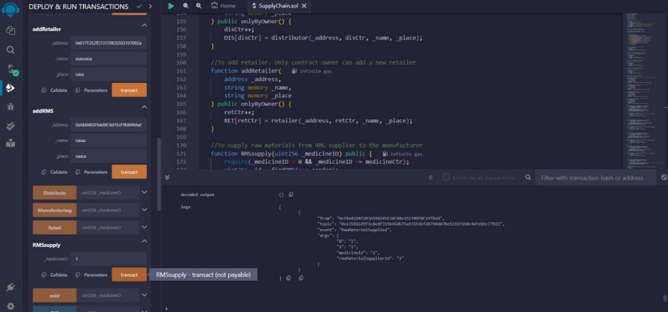
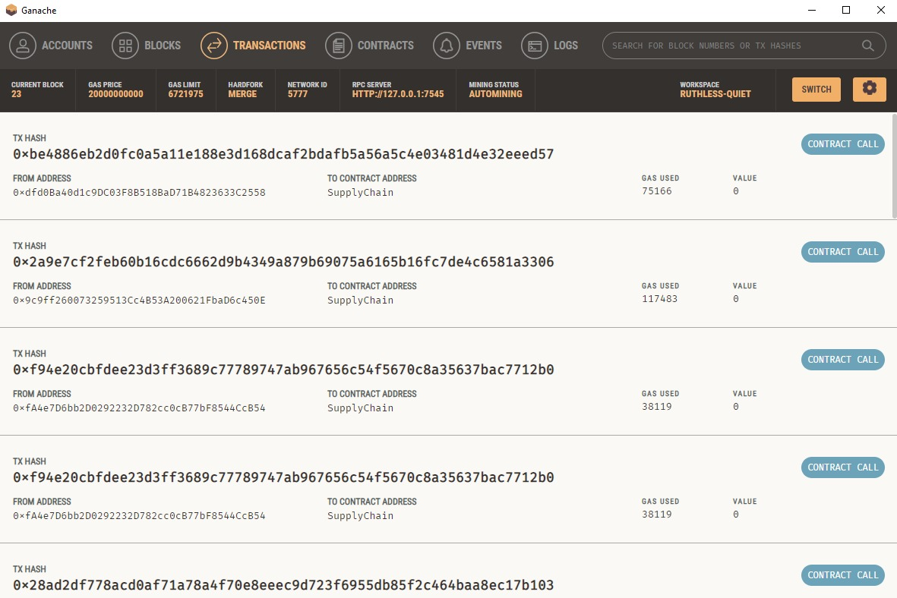
IMPLEMENTATION

Slide 8
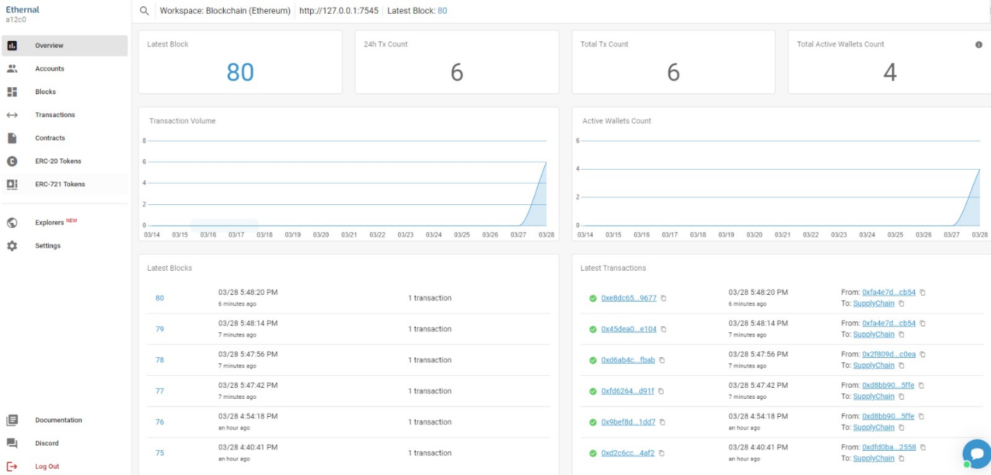
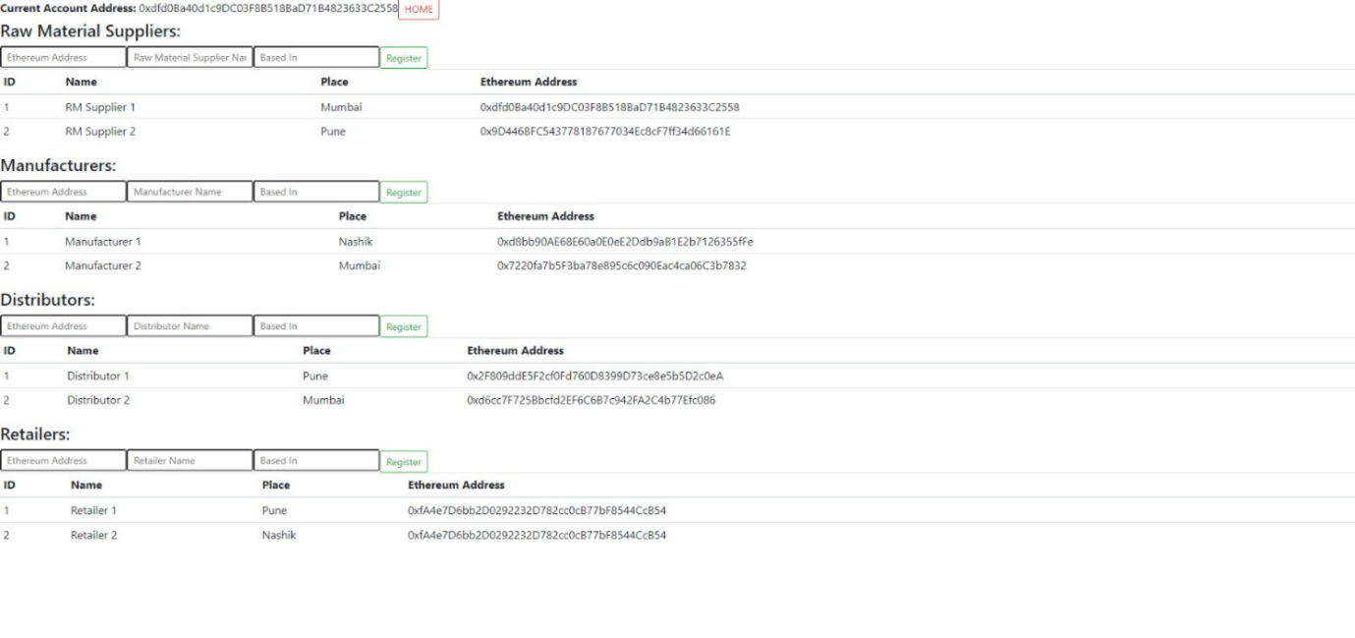
IMPLEMENTATION

Slide 9
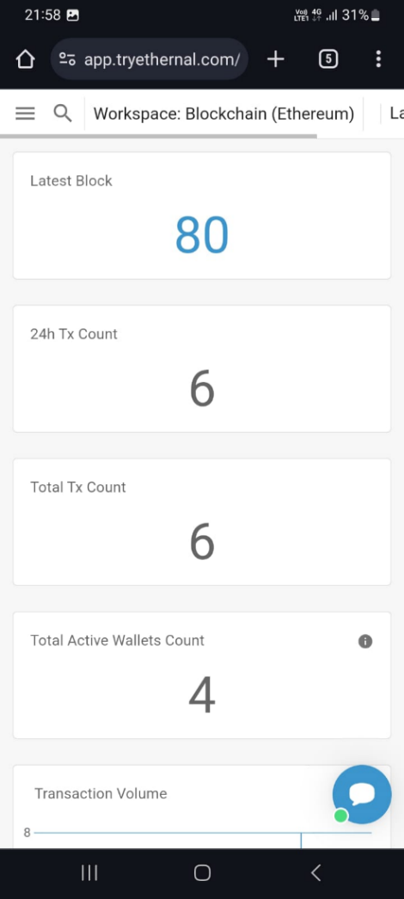
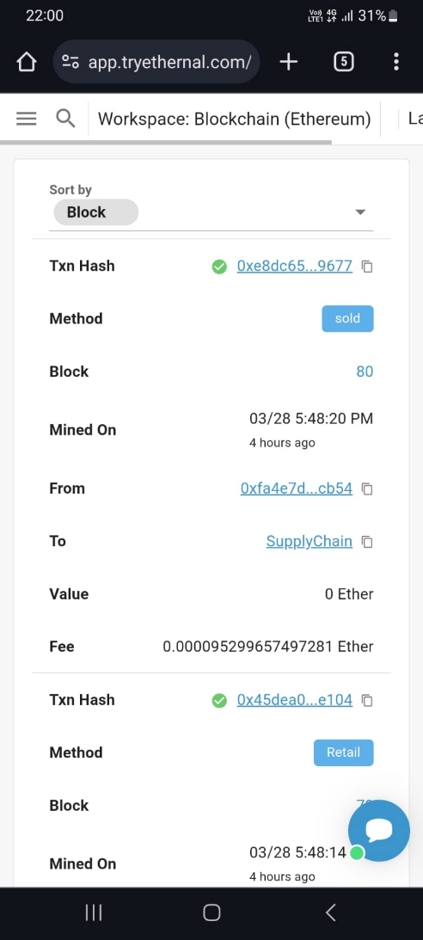
IMPLEMENTATION

Slide 10
TECHNICAL SPECIFICATION
Blockchain Platform: The system will be built on a secure and established blockchain platform, such as Ethereum. This provides the foundation for secure data storage, smart contract execution, and decentralized operations.
Smart Contract Development: Solidity, a programming language specifically designed for Ethereum smart contracts, will be used to develop the core functionalities of the project.
User Interface: A user-friendly web application will be developed to interact with the blockchain and provide an intuitive interface for users to track their medicine and access relevant information.
Ethereum Development Environment:
Remix IDE: An online integrated development environment for writing, testing, and deploying Solidity smart contracts.
Truffle: A development framework for Ethereum that provides tools for compiling, deploying, and testing smart contracts.
Ganache: A personal Ethereum blockchain for rapid development and testing of Ethereum applications.
Solidity Compiler: A compiler for the Solidity programming language, which compiles Solidity code into bytecode that can be executed on the Ethereum Virtual Machine (EVM).
Web Development Tools:
React.js: JavaScript frameworks/libraries for building dynamic and interactive web applications.
Web3.js: A JavaScript library for interacting with the Ethereum blockchain, enabling communication between the frontend and the blockchain network.

Slide 11
FUTURE SCOPE
Further research is recommended to explore additional features and functionalities that can augment the capabilities of the medicine tracking system, such as integrating IoT devices, implementing advanced analytics, and enhancing user interfaces. Collaborative efforts with industry partners, regulatory agencies, and academic institutions can facilitate the adoption and deployment of the system on a larger scale, driving widespread adoption and impact. Continuous monitoring and evaluation of the system's performance, security, and scalability are essential to ensure its long-term viability and effectiveness in addressing the dynamic challenges of the pharmaceutical supply chain. In conclusion, the developed medicine tracking system holds immense promise in revolutionizing the pharmaceutical supply chain landscape, fostering transparency, trust, and efficiency for the benefit of all stakeholders involved. By embracing innovation and collaboration, the project sets a solid foundation for future advancements in supply chain management and healthcare delivery.
Incorporating Internet of Things (IoT) devices for real-time monitoring of temperature, humidity, and other environmental conditions during medicine transportation and storage. This integration can provide valuable data insights and enhance the system's ability to maintain product quality and safety.
Enhanced Data Analytics: Implementing advanced data analytics techniques to analyze the vast amount of transactional data stored on the blockchain. By leveraging machine learning algorithms and predictive analytics, the system can identify trends, patterns, and anomalies in the supply chain, enabling proactive decision-making and risk management.
Interoperability with External Systems: Establishing interoperability with external systems such as regulatory authorities, logistics providers, and healthcare institutions. This integration facilitates seamless data exchange and collaboration, streamlining regulatory compliance, supply chain logistics, and patient care processes.
Mobile Application Development: Creating a dedicated mobile application for stakeholders to access the medicine tracking system on their smartphones or tablets. The mobile app can provide real-time updates, notifications, and alerts, empowering users to track medicine movements and monitor supply chain activities conveniently.

Slide 12
CONCLUSION
The project successfully designed and implemented a blockchain-based medicine tracking system to enhance transparency, traceability, and security in the pharmaceutical supply chain. Through rigorous research and analysis, the project identified the pressing need for improved tracking mechanisms to address challenges such as counterfeit drugs, supply chain inefficiencies, and regulatory compliance. The developed system effectively leverages blockchain technology, smart contracts, and decentralized consensus to create an immutable and transparent ledger for recording medicine transactions and supply chain activities.
The medicine tracking system offers significant benefits to various stakeholders in the pharmaceutical industry, including manufacturers, distributors, retailers, regulatory authorities, and end consumers. By ensuring the authenticity and integrity of medicine products, the system helps mitigate risks associated with counterfeit drugs, product diversion, and supply chain disruptions. The transparency and traceability provided by the system contribute to improved regulatory compliance, quality control, and patient safety, thereby fostering trust and confidence in the pharmaceutical supply chain ecosystem.

